Slide 1
Test-driven Development for SharePoint and Office 365
Bill Ayers

Slide 2












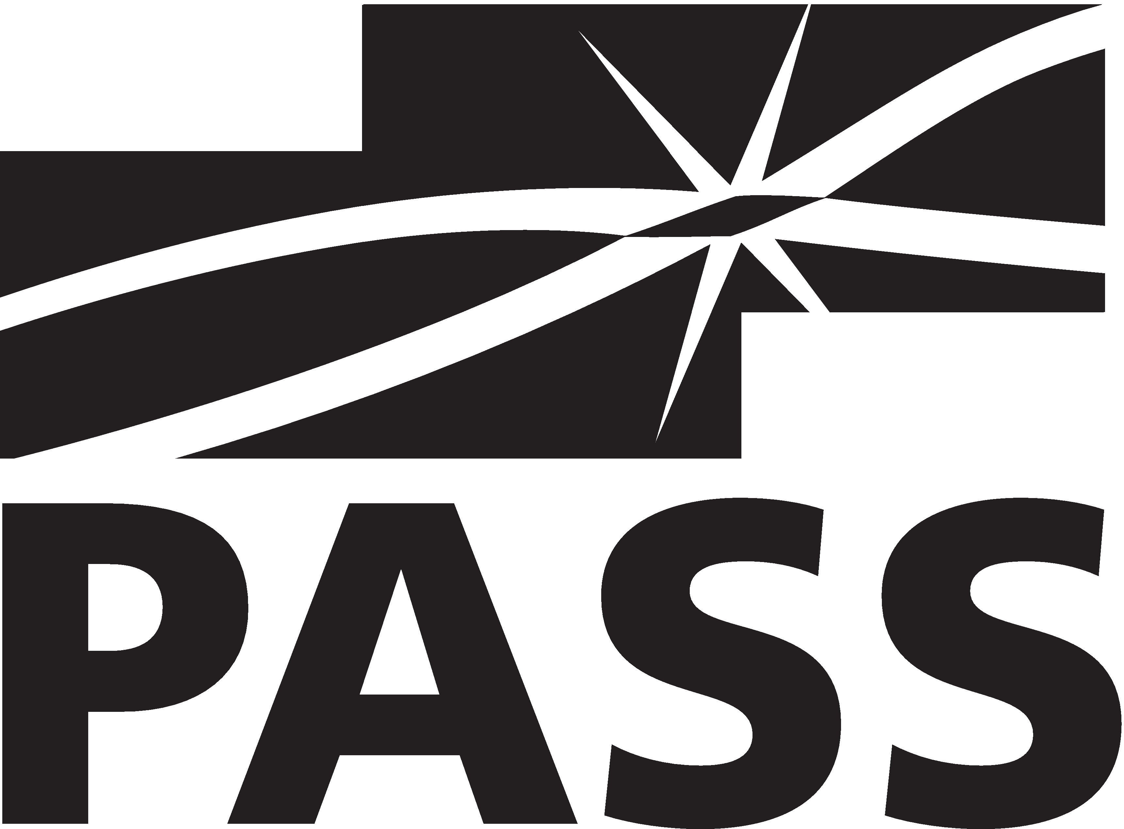

Slide 3

Bill Ayers MCM/MCSM Charter SharePoint
MCT, MCTS, MCITP, MCSD, MCAD, MCSA, MCDBA, Professional Scrum Master, etc.
Flow Simulation Ltd.
www.SPDoctor.net
BillA@flosim.com
@SPDoctor
Consultant specialising in SharePoint and Office 365 Development and Architecture for Collaboration and Mobile Development

Slide 4


Slide 5
Agenda:
Introduction to TDD
Server-side tests
Client-side tests
Conclusions
Notes:
What is TDD
Challenges of farm solutions
New client-side app development
ATDD
There’s a lot of stuff here so I am going to try to keep questions to the end.

Slide 6


What is TDD?
Goes beyond Test-first
Tests drive the low-level design
Supports refactoring
Just a developer tool
Notes:
Just a tool to help development, not a religion, not a philosophy, not a way of life.
Test-driven Development by Example, Kent Beck, Addison Wesley, 2003.
TDD leads to design – emergent design, as opposed to big design up-front. Delay decisions until the last responsible moment. JIT, or possibly earlier, not STL.
Of course you may face objections…
Theory is where you understand everything but nothing works. Practice is where you somehow have everything working but you don’t know why.

Slide 7

TDD Cycle
requirements
write a failing test
refactor
make test pass
Notes:
You start with nothing but requirements
Red-green-refactor.
Small scale agile. This is the cog that drives the minute hand.
Step-by-step.
During refactor you can improve the design but you can’t add functionality.
Detailed design emerges
Unless you have tried it, and perfected the technique, it is difficult to explain how TDD works. Addictive.
TDD is like the Blind Watchmaker of evolution – you follow the rules and the details fall out – obviously you have to know what you are doing in the first place….
So I have decided to have a go:
Write a test – just enough to fail.
Write production code – just enough to pass.
Refactor step is optional – only needed where software design is sub-optimal.
Go back to the start and keep going until you have satisfied all the requirements of the story.
The design and architecture “emerge” as a by-product of following a series of many simple steps, in a way analogous to the theory of evolution.
There is no grand design at the outset.
Over a series of successive small changes, while following good software practices, the design emerges.
Inevitably there will be some up-front design decisions – use common sense.
Tests don’t have to be unit tests, but they must run fast.
Circles within circles: TDD red-green-refactor, inside daily standup, inside sprint, inside iteration/release, inside project.
Note the solution structure separating Unit tests, integration tests and UI tests.
This discipline helps prevent you from writing code you don’t need (YAGNI).
Thinking is more important than coding, and the tests help capture your thoughts.

Slide 8

TDD rulebook
No code unless failing test
Write just enough code to pass test
No new test until green
Refactoring must not add functionality
Tests must be fast
Tests must be easy to run (i.e. automated)
Purpose of test should be clear
Tests should be independent (run in any order)
Test code is a first-class citizen…
Notes:
Don’t add functionality or anticipate future requirements.
Your mission is to just pass the test.
You can improve during refactor but you can’t add functionality.
You can have two developers pairing with one writing tests and the other code.
Tests should test a single thing.
Tests should give a helpful fail message.
Test only a single unit of code.
Test is for the logic – UI is not very testable and probably have different versions for different platforms if doing e.g. mobile. Therefore recommend using declarative code for UI (e.g. HTML/CSS or XAML) and procedural code jfor the logic (i.e. “business” logic).
All these rules are there for a reason…

Slide 9
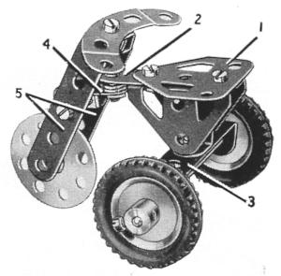
How does TDD work?
Tests facilitate refactoring
Refactoring facilitates incremental design
Failing tests pinpoint problems quickly
Fast (continuous) tests give immediate feedback
Tests should ideally isolate the code you are working on
Rapid feedback – bugs discovered faster
Guarantees test coverage
Tests document the design
Easier to handle interruptions to “flow”
Notes:
Tests must run fast for this to work, and they should ideally be able to run in dev, build and target environment. In practice this probably means out of necessity we will have a combination of unit and shallow integration tests – why “shallow”? Because one could argue that the SP OM framework is integral, like C# runtime.
Tests that isolate code run fast and also help you pinpoint the problem area, often to the extent that you rarely need to resort to the debugger. It’s almost like you instrumented your code with lots of diagnostics, except the diagnostics are outside the code, inspecting its behaviour.
In contrast UI tests that run end-to-end give little clue as to where in the layers the problem lies. And they run at a snail’s pace – no good for TDD.

Slide 10
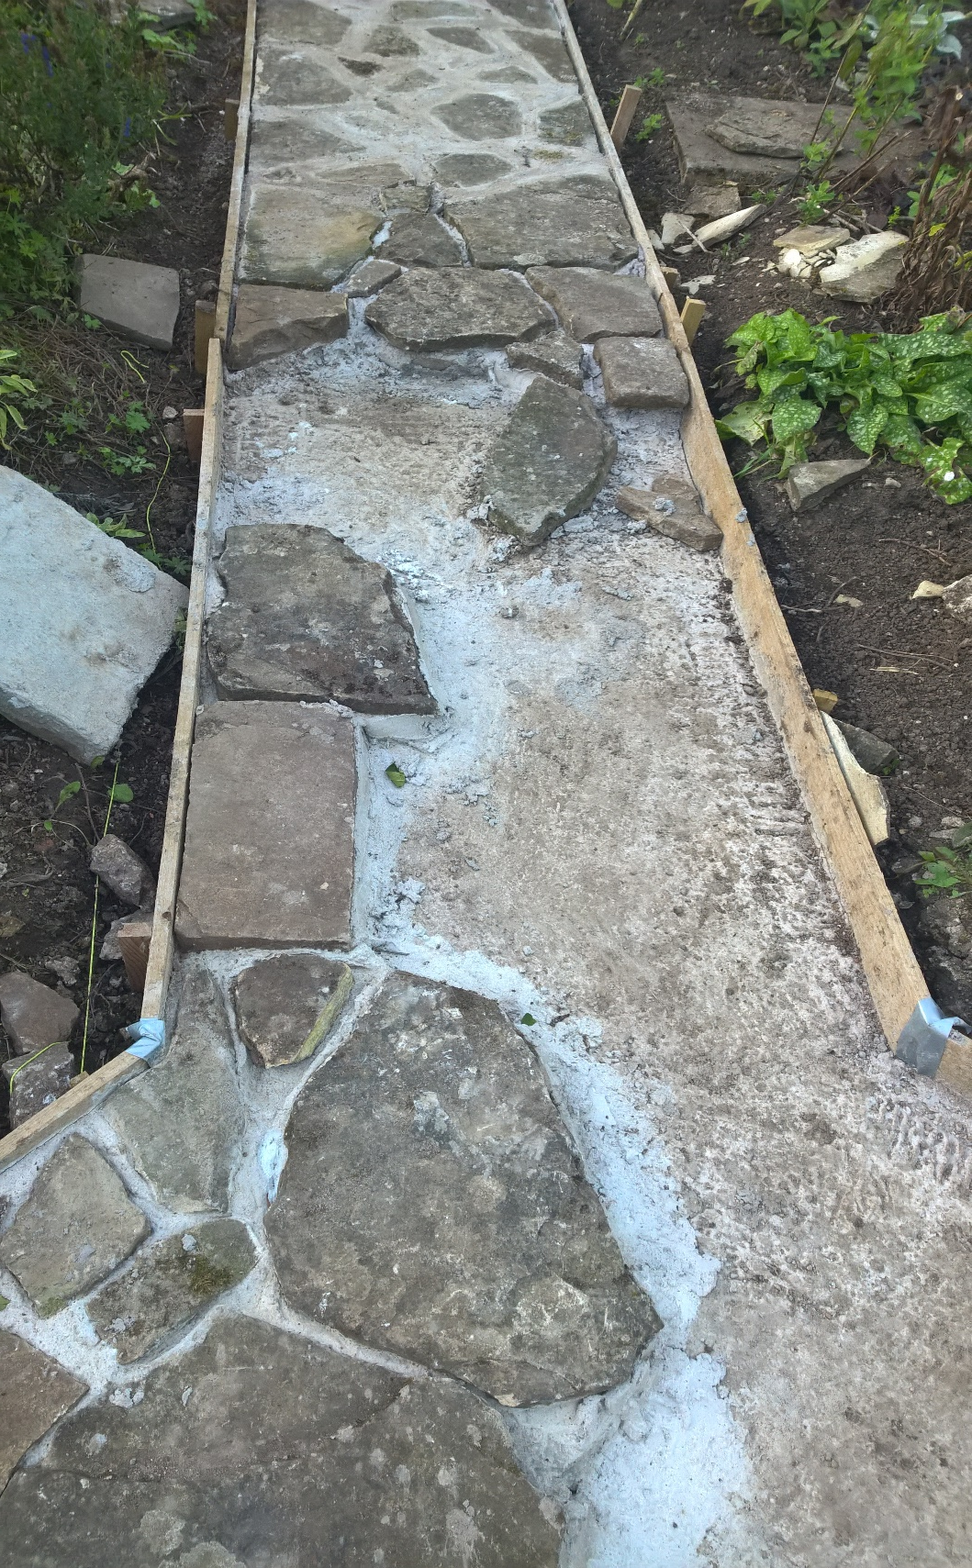
For long-running projects, the tests may outlive the code…
Notes:
For a long-running project, the tests will outlive the code, and ultimately contain the value from a decade of experience and bug reports. The tests are the mould into which you pour code, over and over. Any idiot can write code – good code needs tests.
We are all more fallible than we think, however clever we are, and that’s why so many software projects fail.

Slide 11

Benefits of TDD
Bugs discovered faster
Better productivity (once the technique is learned)
Safe refactoring results in better code design
Cleaner design because enforces KISS and YAGNI
Tests improve code quality and confidence
Tests document the design
Easier to handle interruptions to “flow”
Incremental development
Guarantees test coverage
Enables future maintenance and further development by ensuring existing functionality is maintained (tests)
Strangely hypnotic, especially if you are listening to progressive dance music ;-)
Notes:
Tests can be thought of as an executable specifications, but at the unit test level.
Would like a study that said TDD is x% more effective, but not as simple as that.
Erdogmus, Hakan; Morisio, Torchiano. "On the Effectiveness of Test-first Approach to Programming". Proceedings of the IEEE Transactions on Software Engineering, 31(1). January 2005. (NRC 47445). Retrieved 2008-01-14. "We found that test-first students on average wrote more tests and, in turn, students who wrote more tests tended to be more productive."
But it is not perfect…

Slide 12
Refactoring
Clean up variable and function names for clarity
Make code more concise
Remove spaghetti code
Remove duplicate code
Extract methods to avoid oversize methods
Keep re-running the tests as you re-factor
If test fails then Ctrl-Z, Ctrl-Z, Ctrl-Z …
Notes:
If you keep running the tests you will never stray far from the green path.
Avoid the situation where you make a bunch of complicated changes, code isn’t working, and then the phone rings!
Or… approaching footsteps. They might be about to knock on the door. It is already too late.
Refactoring is key to making the emergent design part work.
You have to do this refactoring step – or you end up with a mess.

Slide 13
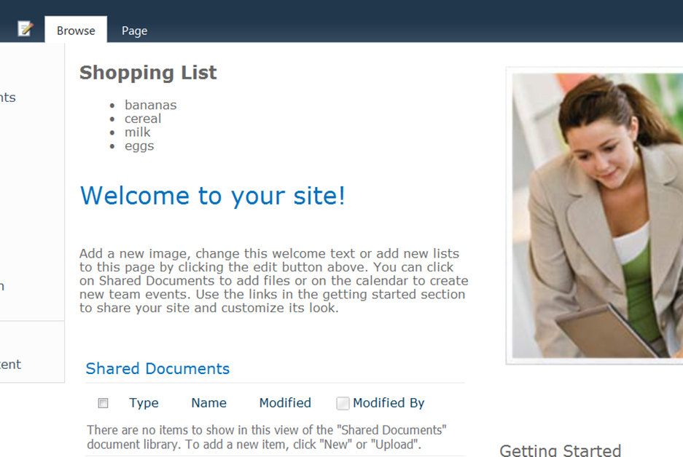
Shopping List Story
As a team site user
I want my shopping list visible on the home page
So that I don’t forget stuff
Acceptance Criteria:
Does a shopping list panel appear on the home page?
Does the panel show all items in the shopping list?
Are the items sorted alphabetically
Notes:
User Story
Would be defined and refined as part of Sprint Planning

Slide 14
Demo: TDD – Introduction
Notes:
Introduction to TDD
SharePoint list is provisioned in site.
Web Part already deployed as Shopping List page
Show how Visual Web-part created (VS2012/13 template is code gen, not an old school user control).
Trivial change - build – deploy – takes a good half minute ☹
Have to find a way of testing quickly.
Unit test project – structure – note the links.
Test class is derived from web part class.
Notice how web part output is captured in “content” variable in test initialise method and re-used in tests.
Using a repository class to wrap the SharePoint call.
Scene is set – time to some TDD.
Initally ASPX is empty.
Write first test:
[TestMethod]
public void RenderContents_ShowsHeading()
{
StringAssert.Contains(content, “<h1>Shopping List</h1>”);
}
Run tests. [Red]
Make test pass by modifying ASPX.
Run tests [Green]
Add test -> contains “Bananas” [Red]
Add to ASPX in design mode [Green]
Add test -> contains “Cereal” (but accidentally delete Bananas) [Red]
Edit ASPX file [Red] ***Regression***
Fix error [Green]
Refactor: Content is hard coded. Use repeater against code behind [Green]

Slide 15

Notes:
DEMO: TDD

Slide 16
TDD hints and tips
Beware excessive use of mocks
You don’t have to get everything right from the get-go
Don’t write meaningless tests – e.g. testing library functions, constructors, language features
Think of tests as a design tool
Fake it ‘til you make it
Tests are like pitons when climbing. You drive in the pitons above your head as you go – Kent Beck
Notes:
Dunning-Kruger effect is a delusion of superiority in unskilled individuals who rate their ability higher than reality. Conversely the more skilled individuals actually rate themselves modestly due to their greater awareness of “known unknowns”.

Slide 17

Time for TDD

Slide 18

Time for TDD

Slide 19

Drawbacks
Not a silver bullet
Can be difficult to maintain discipline under pressure
Difficult in brownfield development
Difficult without management support
Cost of maintaining tests
Can be abused as a quality metric (number of tests)
False sense of security
Not all development is equally suited to TDD
Not appropriate for spikes or other non-production code
Not all code is easy to test (e.g. SharePoint!)
RAID
Notes:
Under the pressure of getting something out of the door, the TDD discipline goes out of the window.
Don’t forget that you can refactor tests
Like lines of code, number of tests can become a false quality metric.
Not a silver bullet: can’t make a poor developer a good developer.
Unit tests in TDD are not whole testing story – still need integration tests, acceptance tests, etc. as part of the QA process.
However, it is a myth that test-first doubles the amount of work. Would be better to call it test-driven design.

Slide 20
Costs and Benefits
http://blog.stevensanderson.com/2009/11/04/selective-unit-testing-costs-and-benefits/
Notes:
Testing Benefit (non-obviousness of code)
Cost of testing (number of dependencies)

Slide 21
Danger : Trivial Test Anti-pattern
Presenter:
string ShowMessage(string message, string name)
{
string messageresult = message + “ “ + name;
return messageresult;
}
View:
Void RenderContents(..)
{
String message = presenter.ShowMessage(“Hello, “, SPContext.Current.User.Name);
textwriter.write(“<h1>” + message + “</h1>”);
}
Test class:
[TestMethod]
Void ShowMessage_returns_correct_message_string()
{
var presenter = new Presenter(_fakeView);
string actual = presenter.ShowMessage(“Hello,”, “Bill”);
Assert.AreEqual(“Hello, Bill”, actual);
}
Notes:
It is possible to go too far and end up with trivial tests. Abstraction of layers mean that tests seem to do something, but actually do nothing.
The many layers of abstraction: View/Presenter/Service Layer/Repository, can obscure what is going on to the point where it is no longer obvious that the test have no value. You can also end up adding too many layers. The disadvantages (cost of creating maintaining and understanding all the extra code) outweigh the benefits.

Slide 22
Types of tests
Test type | Speed | Require Code Access | Need to run on SP | Suit TDD | Suit Dev | Suit QA | Suit Accept | Need Isolation f/w | Tools
Unit | FAST | * |  | * | * |  |  | * | MSTest, NUnit
Client Unit | FAST |  |  | * | * |  |  |  | Browser
Integration (shallow) | MED | * | * | * | * |  |  |  | MSTest, NUnit
Integration (deep) | SLOW | * | * |  | * |  |  |  | MSTest, NUnit
UI | SLOW |  |  |  | ? | * | * (ATDD) |  | VS (Coded UI), Selenium, Watin
Manual | GLACIAL |  |  |  | *
Perf. | SLOW |  |  |  |  | * | ? |  | VS Load Test
Notes:
Review different types of tests – how can apply to SharePoint?
Unit test – unit of code: once meant just manual test – now means automated.
Work through table. TDD can use Unit or Shallow Integration.
Probably want to keep these types of tests in their own project in your solution to make it easy to select which set of tests to run on each environment.
Unit tests – for developers – run fast, isolate code, can help pinpoint code problems.
Integration tests – developers and QA – test more code including underlying f/w like SP object model
End-to-end UI tests – QA and acceptance – don’t require access to code, test from user perspective and can tie in to acceptance criteria, also good for testing CI and dep

Slide 23
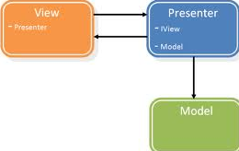
Unit tests with SharePoint SSOM – possible approaches (1)
Public methods, overrides of virtual methods, etc.
Isolate SharePoint calls within a Repository class
Service Locator pattern – P&P guidance
Composite design patterns e.g. MVC/MVP, + conventional mocks and stubs
Notes:
Changing the architecture.
Not suggesting general SP abstraction layer.
Do you need MVP?
Testability often used as justification
Don’t feel you have to separate view and presenter unless you have something for presenter to do
Separation may already exist: e.g. Visual Web Part
Adds many classes and interfaces and can serve to obfuscate rather than simplify if the UI behaviour is trivial (e.g. render a list)
Don’t go for MVP “just in case” - YAGNI
The trick is to find the right balance between complexity and manipulation power so that your tests
remain readable but you get full control of the situation under test - Roy Osherove, The Art of Unit Testing
Tendency to get into a terrible pickle trying to use the latest academic ideas. Desire of ASP.NET devs to try to abstract away SP (guess what, they never really bought in).
Separate unit tests from integration tests in separate projects to make it easy to run tests from one group (e.g. as part of CI)
One test class per app class
“Recommended” approach by P&P group is MVP model. Usually results in its own complexity – multiple classes and interfaces to achieve a simple thing – difficult to achieve separation of concerns – classes tightly bound. Similarly, trying to isolate code from SP model difficult – misses important stuff – many touch points + HttpContext (via. SPContext).
In Sharepoint, the typical activity is making simple web parts that deeply interact with complex SP framework – complexity comes from composition of these web parts into SP-based application.
Use a repository pattern or service layer to expose e.g. a list as a collection of domain objects. This can be integration tested and the rest of the stack can be unit-tested. Often the justification for this pattern is to replace the data storage, e.g. switch from SQL Server to Oracle, or even from SP list to db table – how often does that happen? Can be dismissed as overkill but good for the case where strongly typed business objects represented by a list, particularly if several web parts need to have access to the same business objects. Not so good for e.g. a generic list-rendering web part.
Actually you might conceivably want to switch from SharePoint object model to REST in the SharePoint 2013 model.

Slide 24
MVP/MVVM composite patterns
Do you need MVP?
Testability often used as justification
Don’t feel you have to separate view and presenter unless you have something for presenter to do
Separation may already exist: e.g. Visual Web Part
Adds many classes and interfaces and can obfuscate rather than simplify if the UI behaviour is trivial (e.g. render a list)
Don’t go for complex designs “just in case” – YAGNI
Client-side JavaScript/HTML/CSS provides natural separation
MVVM with data-binding framework easier to justify
Notes:
Are MVPs any good? Some of them are very knowledgeable.
Decision on whether to use MVP pattern may hinge on whether you are paid by the hour. (or better still, by the line of code)
Danger of over-engineering.
“Recommended” approach by P&P group is MVP model. Usually results in its own complexity – multiple classes and interfaces to achieve a simple thing – difficult to achieve separation of concerns – classes tightly bound. Similarly, trying to isolate code from SP model difficult – misses important stuff – many touch points + HttpContext (via. SPContext).
View represents what the user sees, in our case it is where we generate HTML, perhaps using an ascx. The Presenter has the logic for behaviour such as enabling and disabling controls, validation (if you don’t have any presentation logic you probably shouldn’t have a presenter).
I live in the real world where we have to get stuff done – and that is also consistent with the concept of Lean. We can always add a layer later if we need it – this is not an exercise in academic purity.

Slide 25

Unit tests with SharePoint SSOM – possible approaches (2)
Proprietary Mocking frameworks (Typemock Isolator, JustMock, Microsoft Fakes f/w)
Fake SharePoint framework (v. diff.)
Notes:
Only a really stupid person would try to fake the whole of the SharePoint framework – I must take down that codeplex project.
The trick is to find the right balance between complexity and manipulation power so that your tests
remain readable but you get full control of the situation under test - Roy Osherove, The Art of Unit Testing
Tendency to get into a terrible pickle trying to use the latest academic ideas. Desire of ASP.NET devs to try to abstract away SP (guess what, they never really bought in).
Separate unit tests from integration tests in separate projects to make it easy to run tests from one group (e.g. as part of CI)
One test class per app class
“Recommended” approach by P&P group is MVP model. Usually results in its own complexity – multiple classes and interfaces to achieve a simple thing – difficult to achieve separation of concerns – classes tightly bound. Similarly, trying to isolate code from SP model difficult – misses important stuff – many touch points + HttpContext (via. SPContext).
In Sharepoint, the typical activity is making simple web parts that deeply interact with complex SP framework – complexity comes from composition of these web parts into SP-based application.
Use a repository pattern or service layer to expose e.g. a list as a collection of domain objects. This can be integration tested and the rest of the stack can be unit-tested. Often the justification for this pattern is to replace the data storage, e.g. switch from SQL Server to Oracle, or even from SP list to db table – how often does that happen? Can be dismissed as overkill but good for the case where strongly typed business objects represented by a list, particularly if several web parts need to have access to the same business objects. Not so good for e.g. a generic list-rendering web part.
Actually you might conceivably want to switch from SharePoint object model to REST in the SharePoint 2013 model.

Slide 26

Code Coverage (and other dubious metrics)
Your Custom Code
SharePoint .NET
SharePoint Unmanaged Code
ASP.NET
SQL
Windows OS
Notes:
We are standing on the shoulders of giants. Admittedly they are sometimes clumsy giants.
Lines of code, function points, Code coverage – all metrics of dubious value.
A better solution is to focus on testing code that might reasonably break or risky edge cases.
What if a list is empty? Test the stuff that is important. Question the value of test that just scratch the surface.
Unit test “purists” – problem here is that in SP development the interaction with the platform is critical and complex – can’t mock something when you are not sure how it will behave.
In ASP.NET or WinForms platform relatively straightforward. Most of work is in code you write.
In Sharepoint, the typical activity is making simple web parts that deeply interact with complex SP framework – complexity comes from composition of these web parts into SP-based application.
Complexity is in the interaction with SP – non-SP OM code is often relatively simple
at if the list doesn’t exist? What if the schema is wrong?

Slide 27
Unit tests with SharePoint SSOM – possible approaches (3)
Accept shallow integration tests in lieu (“unigration tests”)
Injecting SPContext to web part under test: http://www.spdoctor.com/Pages/article.aspx?name=Unit-Testing-Supplying-SPContext
Notes:
A reasonable approach?
Is it fast enough?

Slide 28
Demo: Server-side testing
Notes:
Server-side Testing
Show shopping list on site, VMs
Shopping List Web Part project structure.
Visual web part structure – VS2012 template. Show how we would create visual web part (note linked files)
Show how the test method captures web part output
Simple tests -> h1, li elements
Red-green-refactor
*Regression*
Refactor -> bind to data-source
Note that the data-source is a fake! (you can also use a powerful mocking framework, but not essential)
Note that everything is using standard VS Pro and OOB stuff.
Note the timings – tests run extremely quickly (because not really calling back to SharePoint or having to deploy the solution).
Reprise:
Replace the fake with real integration tests by enabling integration test project in solution.
Note the ad-hox Dependency Injection and test double. This is really all IOC containers and mocking frameworks do – make this easier but at cost of a great deal of complexity.
Show the integration tests.
Need to make sure to set to x64, TEST->Test Setting -> Default Processor Architecture
Note the timings – still not too bad.
Deploy web part in page -> we are seeing it running for first time!

Slide 29
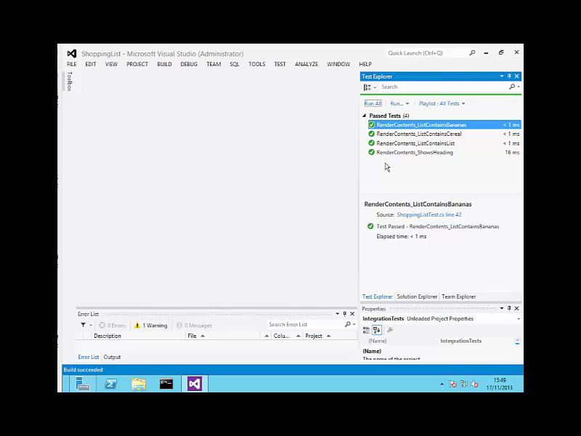

Slide 30
Client-side testing
The new model – SharePoint-hosted Apps
Unit testing JavaScript as a first-class citizen
Shallow integration (“unigration”) tests
Faking the _api and Office 365 REST endpoints
MVVM data-binding patterns
Notes:
Joyous news! Our job in using TDD just got a whole lot easier.
JavaScript sometimes not seen as “proper” code and therefore not tested. “No code” solutions. Once the domain of the front-end developer.
A lot of the observations here are equally relevant to SharePoint 2010 and earlier, where we are already starting to use client-side code, i.e. JavaScript. JavaScript can get delivered to the client in many ways, e.g. in pages, web parts or Content Editor web part.
Client-side development actually lends itself quite well to iterative requirements and emergent architecture.

Slide 31
Client-side testing
The new model – SharePoint-hosted Apps Add-ins
Unit testing JavaScript as a first-class citizen
Shallow integration (“unigration”) tests
Faking the _api and Office 365 REST endpoints
MVVM data-binding patterns
Notes:
Joyous news! Our job in using TDD just got a whole lot easier.
JavaScript sometimes not seen as “proper” code and therefore not tested. “No code” solutions. Once the domain of the front-end developer.
A lot of the observations here are equally relevant to SharePoint 2010 and earlier, where we are already starting to use client-side code, i.e. JavaScript. JavaScript can get delivered to the client in many ways, e.g. in pages, web parts or Content Editor web part.
Client-side development actually lends itself quite well to iterative requirements and emergent architecture.

Slide 32
Client-side testing
The new model – SharePoint-hosted Apps Add-ins SharePoint Framework
Unit testing JavaScript as a first-class citizen
Shallow integration (“unigration”) tests
Faking the _api and Office 365 REST endpoints
MVVM data-binding patterns
Notes:
Joyous news! Our job in using TDD just got a whole lot easier.
JavaScript sometimes not seen as “proper” code and therefore not tested. “No code” solutions. Once the domain of the front-end developer.
A lot of the observations here are equally relevant to SharePoint 2010 and earlier, where we are already starting to use client-side code, i.e. JavaScript. JavaScript can get delivered to the client in many ways, e.g. in pages, web parts or Content Editor web part.
Client-side development actually lends itself quite well to iterative requirements and emergent architecture.

Slide 33

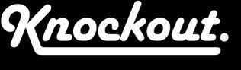

Model-View-ViewModel (MVVM)
C#/XAML
JavaScript/HTML5
ViewModel
Data binding
Model
View
REST (or CSOM)
Notes:
Model is embedded in ViewModel (if not a separate “class”) but is maintained by REST calls to SharePoint (or other system). For arguments sake you could think of the model as what is behind the endpoint.

Slide 34



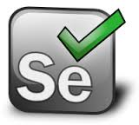
Options for client-side JavaScript testing
Ad-hoc tests (e.g. console logging)
QUnit (qunitjs.com)
TDD style
Jasmine
BDD style
Mocha
BDD or TDD style
PYO assertion library
UI tests (e.g. Selenium, VS UI tests)
Notes:
The assert style of QUnit is close to MSTest and NUnit. Jasmine’s BDD style use fluent style calls to build up English-like structures.
Increasingly we have significant amounts of JavaScript “business logic”, e.g. viewmodel, and we would like to test it in isolation.
Fast changing field – probably three more JavaScript test frameworks since I last checked.
The assert style of QUnit is close to MSTest and NUnit. Jasmine’s BDD style use fluent style calls to build up English-like structures.
Increasingly we have significant amounts of JavaScript “business logic”, e.g. viewmodel, and we would like to test it in isolation.

Slide 35


Running tests
Can run tests in a browser window
Chutzpah test runner
Command line and Visual Studio integration
Only supports Jasmine and Qunit
For Continuous Integration use PhantomJS
Headless browser
Chrome browser engine (WebKit)
Phantomjs.org
Use a cloud test service for “cross-browser test”
Includes device browsers
Notes:
Run in browser window – duh.
Chutzpah provides Visual Studio integration.

Slide 36
Demo: SPFx Tests
gulp test
Notes:
Client-side Testing
Open SharePointClientTest project in SharePointApp1. Review project structure.
Tests directory – html file test.html -> contains references to qunit.js, supporting libraries, qunit.css (modified to make green bar bigger)
Note special elements in page used by qunit test runner
Test.js contains the actual tests. Qunit tests using jQuery against elements in the page (UI tests).
testViewModel.js contains tests against the view model itself, which are true unit tests.
I have added a meta refresh tag to test.html to make it auto-refresh – continuous feedback.
Mockjax is used to mock out the ajax calls to SharePoint – a very convenient separation.
Note that the ajax calls won’t work in the browser because of XSS protection. Need to enable in browser.
If you want to debug, set test.html as start page and debug the JavaScript using Visual Studio. Another option is to use the browser debug tools.
Create a test [Red]
Minimal code to satisfy test. [Green]
Refactor [Green]
You can also use Chutzpah to run in VS Test Explorer.
I found Chutzpah VS integration performed tests slowly and tests didn’t always keep up with code changes.
Tweaked CSS to my liking. Wanted a bigger green/red banner.
Added a meta refresh tag so I can edit and get near instant feedback.
Now we can do some TD :-D!
Make our test page the start page and we can debug!
Mention mockjax.

Slide 37
Using QUnit
Create a simple web project in Visual Studio
Tests defined in JavaScript test files
Test page has div to show results
module("Test the scoring logic");
app = window.app || {};
test("Score of -100/10 gives appropriate summary", function () {
app.viewModel.numberQuestions = 10;
app.viewModel.currentScore = -100;
equal(app.viewModel.scoreMessage(), "Scoring error...");
});
Notes:
Run in browser window – duh.
Chutzpah provides Visual Studio integration.

Slide 38
Demo: Client-side testing
Notes:
Client-side Testing
Open SharePointClientTest project in SharePointApp1. Review project structure.
Tests directory – html file test.html -> contains references to qunit.js, supporting libraries, qunit.css (modified to make green bar bigger)
Note special elements in page used by qunit test runner
Test.js contains the actual tests. Qunit tests using jQuery against elements in the page (UI tests).
testViewModel.js contains tests against the view model itself, which are true unit tests.
I have added a meta refresh tag to test.html to make it auto-refresh – continuous feedback.
Mockjax is used to mock out the ajax calls to SharePoint – a very convenient separation.
Note that the ajax calls won’t work in the browser because of XSS protection. Need to enable in browser.
If you want to debug, set test.html as start page and debug the JavaScript using Visual Studio. Another option is to use the browser debug tools.
Create a test [Red]
Minimal code to satisfy test. [Green]
Refactor [Green]
You can also use Chutzpah to run in VS Test Explorer.
I found Chutzpah VS integration performed tests slowly and tests didn’t always keep up with code changes.
Tweaked CSS to my liking. Wanted a bigger green/red banner.
Added a meta refresh tag so I can edit and get near instant feedback.
Now we can do some TD :-D!
Make our test page the start page and we can debug!
Mention mockjax.

Slide 39


Slide 40
Continuous Integration SharePoint Hosted Add-in or other Client-side development
SharePoint Online
Testing tenant or isolated site collection in production depending on app functionality
Visual Studio online or TFS
Storage of the source code
Automated builds
Coded UI / Build verification Tests
Deployment automation with PowerShell and build definitions
4
1
SharePoint On-Premises
Integration testing environment
Possible isolated site collection in production environment, depending on app functionality
2
3
Notes:
Code is checked in for the cloud or on-premises team foundation system
All automation is performed in the TFS side
Test execution and follow up using TFS tooling
Deployment of the SP hosted app to SharePoint can be automated suing PowerShell. SharePoint could be on-premises or cloud, really no difference on how the deployment will happen, except on exact technical details related on the PowerShell based automation for the authorization.

Slide 41
Continuous Integration Provider Hosted Add-in
SharePoint Online
Testing tenant or isolated site collection in production depending on app functionality
Could be also on-premises SharePoint
Visual Studio online or TFS
Storage of the source code
Automated builds
Coded UI / Build verification Tests
Deployment automation with PowerShell and build definitions
4
1
5
Microsoft Azure
Provider hosted code is deployed as automated process to the cloud platform
Could be also on-premises or IAAS with private cloud setup
2
3
Notes:
Code is checked in for the cloud or on-premises team foundation system
All automation is performed in the TFS side
Test execution and follow up using TFS tooling
Deployment of the app file to the SharePoint, which could be on-premises or cloud. Notice that since the app file part does not change that often, you will only need to trust the app when there are changes either in the app web or in the needed oAuth permissions. Typically you don’t need to redeploy the app file to the SharePoint, which will make the process easier
Deployment of the actual provider hosted app to the provider hosted platform as PAAS, IAAS or on-premises setup. Since majority of the changes are applied on the provider hosted code side, this is the part which you’d be deploying as part of the automated builds. App file only when needed.

Slide 42
Testing process in high level
SharePoint Online
Testing tenant or isolated site collection in production depending on app functionality
Could be also on-premises SharePoint
Execute Tests
<<deploy app>>
C#
3
<<deploy app>>
1
2
Microsoft Azure
Provider hosted code is deployed as automated process to the cloud platform
Could be also on-premises or IAAS with private cloud setup
4

Slide 43
Tips for Testing JavaScript
To be able to Unit Test you need units
In JavaScript the unit of code encapsulation is the function
Very difficult to test an anonymous function
Very difficult to test a hidden function – may need to compromise encapsulation to make testable
Isolate tests from mark-up to avoid fragility
Maintain the quality of test code
Notes:
If test relies on a complex selector to obtain a DOM element, it is brittle if changes are made to the HTML structure. One fix is to use special CSS classes to pinpoint a particular element.
Treat test code as first-class citizen – no sloppy JavaScript.

Slide 44
The Acceptance Test Driven Development Cycle
User Story
Write Automated Acceptance Tests
write test
refactor
Acceptance Tests Pass
pass
Demo to PO
QA
Notes:
ATDD, and BDD, are similar principles to TDD but applied beyond the development team. If working correctly, should not need separate QA step because QA responsible for acceptance tests.
Idea is that BA writes acceptance scripts as part of requirements – never seen this happen – normally QA writes acceptance tests.

Slide 45
How does ATDD work?
Similar to BDD
A DSL for business users to define automated acceptance tests
Tooling such as Fitnesse, SpecFlow
Developer creates generic test fixtures
Can write tests first to drive development (outer loop – inner loop is TDD)
Gives test team something to do at start of sprint
Notes:
ATDD - executable specification – flips it the other way around: instead of the test name being just descriptive, the test name actually generates the test (but requires a lot of developer effort to make this work).
Capture stories - as a, I want, so that - drill down to given when then.
Exec. specs. can be version controlled along with code.
Specflow. Speclog.
BDD – Dan North, Given-when-then.

Slide 46
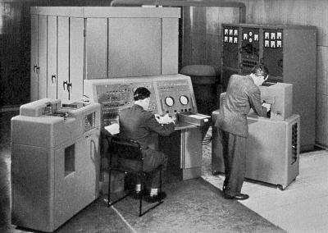
How do we do acceptance tests?
End-to-end testing
No requirement for tests to be fast (within reason)
Tools like SpecFlow can be used to define tests (but is it justified?)
More likely a QA professional will manually build automated QA tests
Tools:
Selenium WebDriver
Visual Studio UI tests
Notes:
With acceptance tests we are no longer constrained by having to make the tests fast, so we can test end-to-end.

Slide 47

End-to-end Testing
Drives application through the UI, simulating the actions of the user
Selenium WebDriver, Watin, Visual Studio
Can target different browsers
Fully tests DOM manipulation, JavaScript, interaction with back-end (i.e. SharePoint)
These tests often written by a dedicated tester
Can be used for TDD if they are fast enough

Slide 48
Demo: UI Testing
Notes:
Could use calculator sample using Selenium WebDriver

Slide 49
Approval Tests
Asserts can be tedious to set up, especially for complex objects
Approval Tests go beyond asserts by verifying against a complex object
When test fails a diff tool shows the cause
When you make a change that needs to update the approval you can “approve” the current output to lock it in to the regression suite
Especially useful for building regression tests around pre-existing code prior to refactoring
Nuget package: Install-Package ApprovalTests

Slide 50
Resources
http://approvaltests.sourceforge.net/
https://github.com/approvals
Nuget package: Install-Package ApprovalTests
http://dontcodetired.com/blog/post/Beyond-Simple-Asserts-with-ApprovalTests.aspx

Slide 51
“Smart Tests”
Available in Visual Studio 2015
Automatically generated tests based on analysis of execution paths
Based on Pex from Microsoft Research
Notes:
Useful tool for getting code coverage for existing code.

Slide 52


Conclusions
Test Driven Development continues to gain traction in the development community as a whole and brings many benefits
Does not replace acceptance tests
SharePoint challenges us to find new ways of testing code that depends on server interaction
The SharePoint Framework brings us into the world of client-side testing
JavaScript client-side code is easier to test than server-side SharePoint code
Make TDD part of your professional development practice… where it makes sense ☺
Notes:
Traction
Challenges
2013 Client-side
Easier
If you have been deterred from TDD in the past because of the complexities of SharePoint, it is time to look again, particularly if you are doing client-side development.

Slide 53
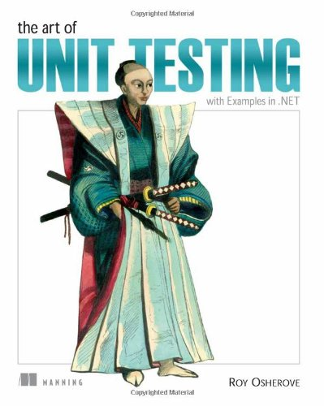
Recommended Reading:
“The Art of Unit Testing”, Roy Osherove
“Test-Driven Development by Example”, Kent Beck
Lean-Agile Acceptance Test-Driven Development, Ken Pugh
Notes:
This is an Agile talk about Agile and I am continually trying to improve it.
This the first interim deployment – further releases are scheduled over next few months.
I am the developer, you are my product owner and I welcome your feedback. Thank you.
SharePoint Connections, Amsterdam
SharePoint Saturday, Nottingham
SharePoint Live!, Orlando
European SharePoint Conference, Copenhagen
BDD – MSDN Mag. http://msdn.microsoft.com/en-us/magazine/gg490346.aspx
DaedTech: http://www.daedtech.com/intro-to-unit-testing-9-tips-and-tricks
Create separate test project in solution.
Personally, I recommend linking files rather than referencing the production project (sometimes fails to reload/update on changes).
One test file per source file, one test class per source class.
Naming of tests – make clear what testing and using a convention, e.g. methodname_given_then_when (BDD style).

Slide 54

Contact me:
Blog: www.spdoctor.net
Twitter: @spdoctor
Sharepoint.stackexchange.com (moderator)
Email: BillA@flosim.com

